Slide 1
UNIT IV: ELECTRODYNAMIC FIELDS
Presentation by
Dr. Rajasi Mandal
Assistant Professor
EEE
SSN College of Engineering

Slide 2
Session Objectives
  To apply concepts related to electrostatics, magnetostatics, and electrodynamics in obtaining Maxwell’s equations.

Slide 3
Session Outcomes
  Students will be able to design and analyze an electromagnetic device applying Maxwell's equations. (CO4)

Slide 4
Session Outline
  Time-varying Electromagnetic Field
  Electromagnetic Induction
  Faraday’s Law
  Lenz’s Law
  Conduction Current and Displacement Current
  Maxwell’s Equations: Integral and Differential Forms
  Maxwell’s Equations for Different Conditions

Slide 5
Time-varying Electromagnetic Field
Stationary charges produce Time-invariant Static Electric Field.
Charges moving at a constant velocity or steady current produces Time-invariant Static Magnetic Field.
Charges moving at non-uniform velocity i.e. time varying current produces Time-varying Electromagnetic Field.

Slide 6
Electromagnetic Induction
The electric field and the magnetic fields are independent to each other in Time-invariant Static Fields. However, the electric field and the magnetic fields are inter-dependent on each-other in Time-varying Fields.
In 1820, Oersted observed a steady current carrying conductor can produce magnetic field.
In 1831, Faraday observed that change in magnetic lines of force through a closed conducting coil can produce electric current through it. This phenomenon is called Electromagnetic Induction.
The generation of electric current in a closed coil due to the change in the number of magnetic lines of force passing through the coil is known as Electromagnetic Induction.
The current produced in a closed conducting coil due to electromagnetic induction is called induced current.
The emf produced in a conducting coil due to electromagnetic induction is called induced emf.
Practice Problem 1 A conductor of length 70 cm moves at an angle of 45° through an uniform magnetic field with 10,000 lines/m² with the velocity of 40 m/s. Find the value of induced emf in the conductor if 1 Wb/m² = 10⁴ lines/m² = 10⁴ Gauss.
Hint: Induced emf = Blv sinθ (The direction can be found using Flemming’s Right Hand Rule.)

Slide 7
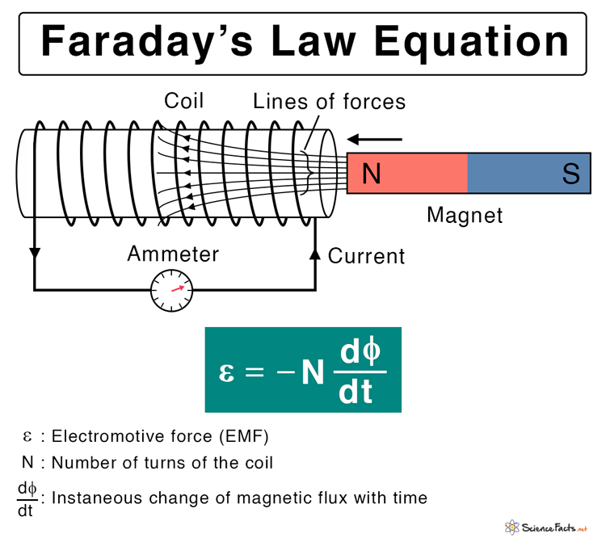
Faraday’s Law
1st Law: Whenever there is a change in the number of magnetic lines of force passing through a closed coil, an emf is induced in the closed coil.
2nd Law: The magnitude of the induced emf is directly proportional to the rate of change of magnetic lines of force passing through the coil.
Lenz’s Law
The direction of the induced emf is such that it always opposes the cause that produces it.
induced

Slide 8
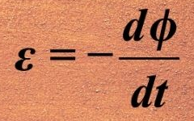
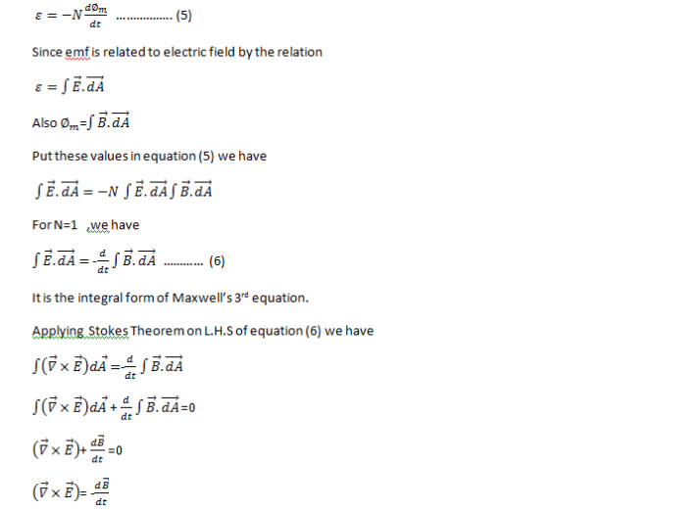
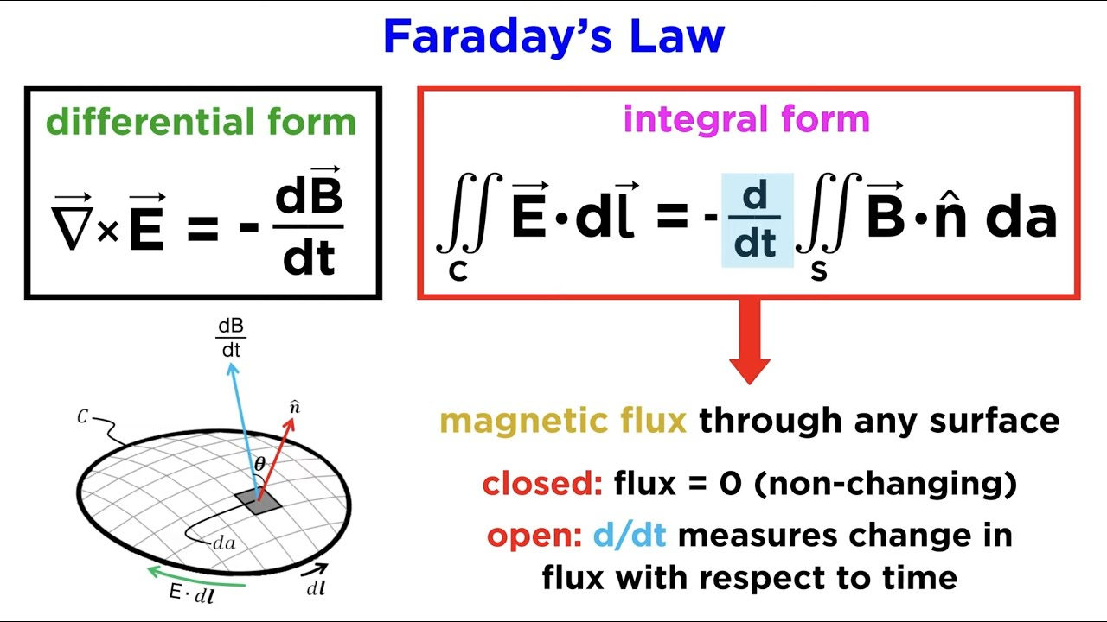
Integral and Differential Forms of Faraday’s Law

Slide 9
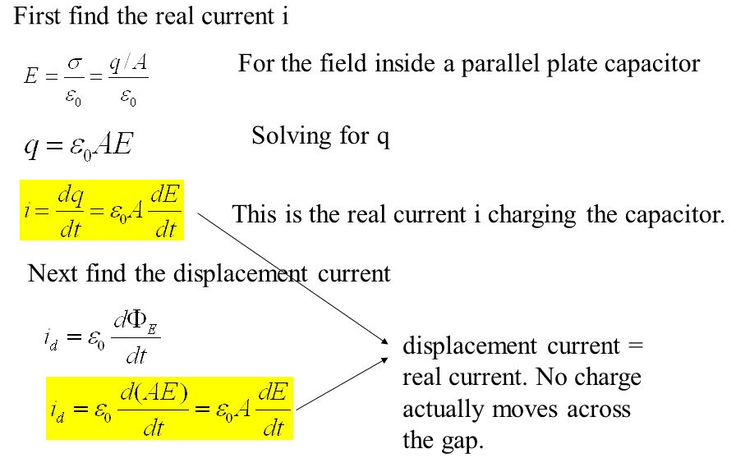
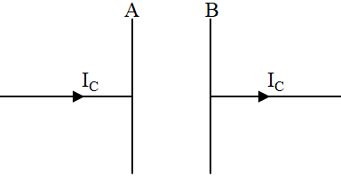
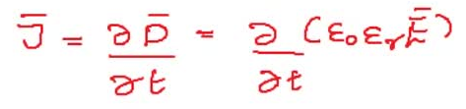
Displacement Current
Displacement Current is defined as the current set up in a dielectric medium due to a time-varying electric field through it.
The continuity of current through the entire circuit is maintained by conduction current through the conducting wire and displacement current through the dielectric medium of the capacitor.
In case of an ideal capacitor, conduction current through the wire is equal to the displacement current through the dielectric medium of capacitor.
I_{d}
Displacement Current Density,
Not a
d

Slide 10
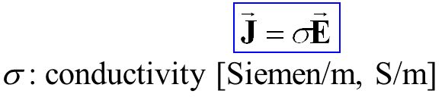
Comparison between Conduction Current Displacement Current
 | Conduction Current (I_{c}) | Displacement Current (I_{d})
1 | Conduction Current (I_{c}) is the actual current that flows through a conducting medium (σ≠0). | Displacement Current (I_{d}) is the apparent current which is produced due to the time-varying electric field within a dielectric medium (σ=0).
2 | Conduction Current (I_{c}) obeys Ohm’s law i.e. I_{c}=V/R. | Displacement Current (I_{d}) does not obey Ohm’s law.
3 | Conduction Current Density (J_{c}) is represented as, | Displacement Current Density (J_{d}) is represented as,
4 | Conduction Current Density (J_{c}) indicates the conducting power of a conducting medium. | Displacement Current Density (J_{d}) indicates the power of permittivity of a dielectric medium.
d
Practice Problem 2 Find the maximum values of the displacement current and the conduction current through an ideal capacitor of 5 pF. The voltage applied across the capacitor is V = 0.2 sin(100π)t V.
Practice Problem 3 Find the amplitudes of the conduction current density and the displacement current density in a material having electrical conductivity, σ = 10⁻⁴ mho/m and relative permittivity, ε_{r} = 2.5. The electric field in the the material is E = 6×10⁻⁵ sin(8×10⁸)t V/m.

Slide 11
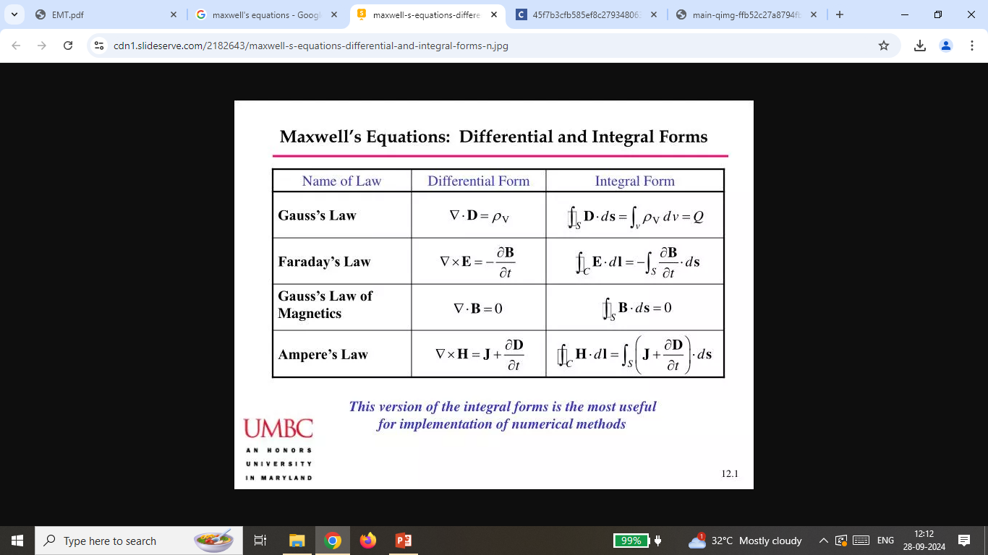
Maxwell’s Equations: Integral and Differential Forms
 | Differential Form | Integral Form | Derived from | Steady state or Time-dependent | Significance
1 |  |  | Gauss's Law of Electrostatics | Steady state | The total electric flux through a closed surface is 1/ε₀ times the net charge enclosed by the surface. Electric field lines start from positive charge (source) and end at negative charge (sink).
2 |  |  | Gauss's Law of Magnetostatics | Steady state | The divergence of magnetic field is zero. Magnetic monopole does not exist. The magnetic poles appear in pair only. There is no source or sink for magnetic field lines.
3 |  |  | Faraday's Law of Electromagnetic Induction | Time dependent | An electric field is produced due to the change of magnetic flux with time.
4 |  |  | Maxwell's modified Ampere's Law | Time dependent | A magnetic field is produced from an electric current.
c
c

Slide 12
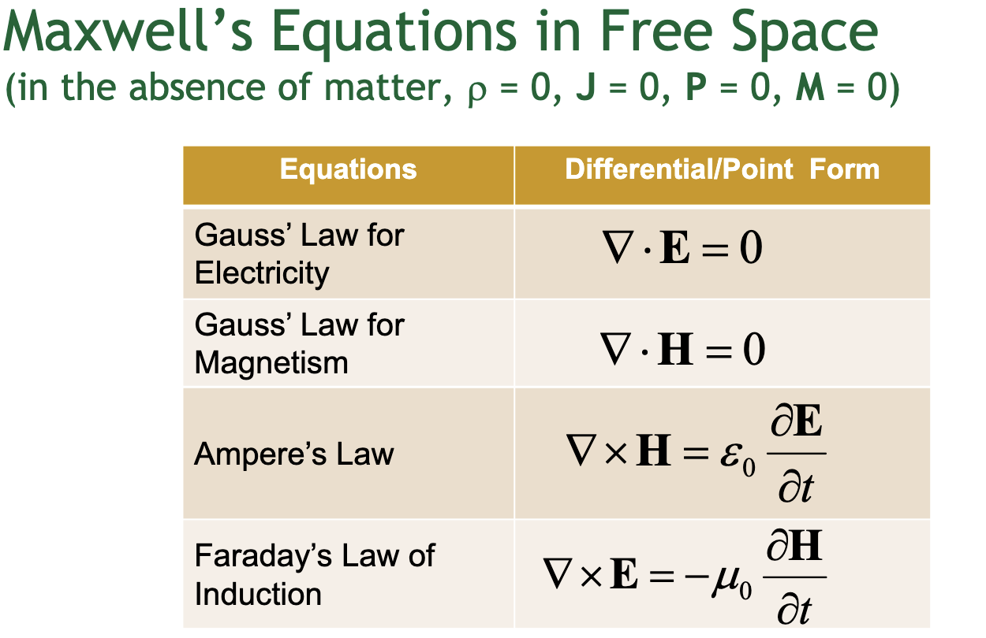
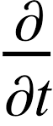
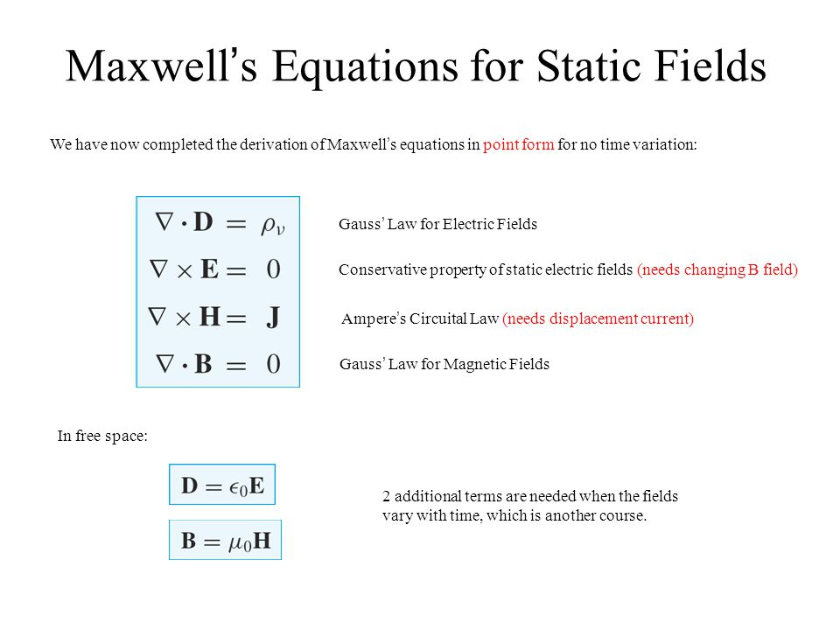
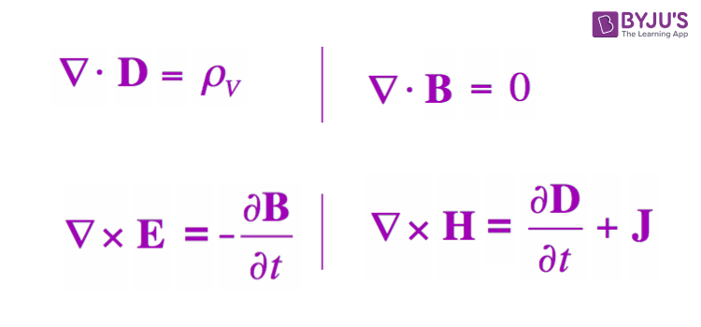
Maxwell’s Equations for Different Conditions
 | Conditions | Constraints | Maxwell’s Equations
1 | Free Space or Vacuum | ρ=0, and σ=0, J_{c}=σE=0. D=ε₀E, and B=μ₀H.
2 | Static Fields or Time Invariant Fields | D=0, and B=0.
3 | Good Conductors | ρ=0, and J_{d}= D=0.
4 | Dielectrics | ρ=0, and σ=0, J_{c}=σE=0.
c
c

Slide 13
Test Your Understanding
What is an electromagnetic induction? State Faraday’s law and Lenz’s law. Derive the integral form and the differential form of Faraday’s law of electromagnetic induction.
What is a displacement current? Deduce an expression for displacement current density.
State the differences between Conduction current and displacement current.
Write the 4 Maxwell’s equations in both differential form and integral form. Explain the significance of each of the 4 Maxwell’s equations.
Derive all the 4 Maxwell’s equations for time-varying electromagnetic field.
Find the modified versions of the Maxwell’s equations for the following conditions:
    Free-space or vacuum,
    Static field or time-invariant field,
    Good conductor,
    Dielectric.
NOTE:- No need to submit this.

Slide 14
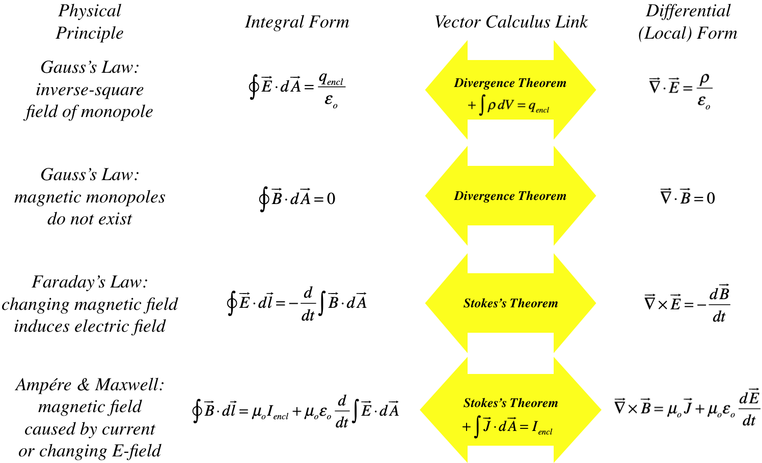
Summary

Slide 15
References
A Text Book on Classic Engineering Physics, Amal Kr. Chakrabarty.
Engineering Electromagnetics, William H. Hayt, Jr., John A. Buck.
Field and Wave Electromagnetics, David K. Cheng, Pearson New International Edition.
Elements of Electromagnetics, Matthew N. O. Sadiku, Oxford University Press.
Electromagnetic Waves and Radiating Systems, Edward C. Jordan, Keith G. Balmain, Prentice-Hall Inc.

Slide 16
Thank you !

